Slide 1
Finding Opportunities
in Challenging Times
Guide to a meaningful conversation – A coaching approach

Slide 2
What you need to know before the conversation
DURATION | FORMAT | QUESTIONS
60 to 90 minutes | Videoconference with a maximum of 8 participants | You can choose whether or not to share the questions in advance
Qualities of a good conversation
Empathetic | Open | Supportive
Curious, not judgmental | Growth mindset | Generous listening
Notes:
Invitation email:
You may wish to use the prepared invitation email that explains the reason for the session on "Finding opportunities in challenging times."
Questions:
You know your employees, so you are the best person to decide if you should distribute the questions in advance.
Duration:
The larger the group, the longer it takes to complete the four stages of the GROW model.
It is essential to set aside at least ten minutes at the end of the session to allow the participants to speak about what actions they are willing to take, try or change.
Empathy:
Empathy is essential throughout the conversation as each employee will experience the situation in their own way.
Some employees will find it easy to explore different possibilities, whereas others may not.

Slide 3
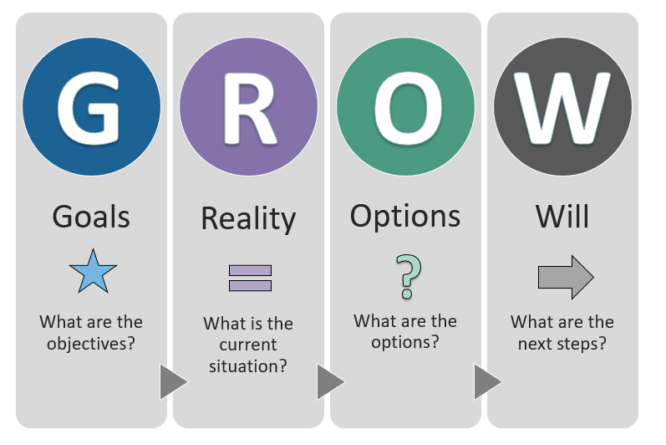
GUIDED CONVERSATION
Inspired by the GROW model of coaching and mentoring
Notes:
The GROW model is usually used in individual coaching sessions.
For our purposes, however, the GROW model has been adapted slightly to allow for a group conversation on a single topic.
For this conversation, the stages in the GROW are as follows:
G-GOALS: What are the objectives of the conversation/meeting?
R-REALITY: What is the current situation each employee is experiencing?
O-OPTIONS: What options are available for employees?
W-WILL: What are the next steps that each employee wants to take/try/change in the right direction?

Slide 4
Part 1
GOALS
Better understand how each employee is dealing with the current situation
Identify strategies for maintaining a critical work-life balance at this time
Explore as a team how we can transform the way we work during this period
DURATION
10% of the session

Slide 5
Part 2
REALITY
SCALE OF 1 to 10
On a scale of 1 to 10
(10 being optimistic, 1 being pessimistic),
how are you feeling in the current situation?
BIGGEST CHALLENGE
What is your biggest challenge?
DURATION
15% of the session

Slide 6
RESILIENCE
How do you recharge?
What should you do more (or less) often?
FOCUS ON STRENGTHS
What are your greatest strengths
at this challenging time?
WHAT IF…
What could happen if we doubled your self-confidence?
LEARNING
What would you do if you knew you couldn’t fail?
CREATIVE MIND
Given the current context, what needs to be reinvented?
GIVING YOURSELF ADVICE
If you were giving yourself advice, what would you tell yourself right now?
Part 3
OPTIONS
Choose 4 to 6 questions
DURATION
60% of the session
Notes:
This step will help participants adopt a growth mindset by exploring the possibilities available to them.
The suggested process allows individuals to explore previously uncharted pathways.

Slide 7
Part 4
WILL
What actions will you take?
LEARNING
What have you learned today that will help you cope with the current situation?
STEPS IN THE RIGHT DIRECTION
What are you willing to do, try or change to move
in the right direction?
DURATION
15% of the session
How can I support you?
Notes:
For this last step, each participant should bear in mind that every move in the right direction, big or small, should be seen as a sign of progress.
In turbulent times, the pace of development of individuals will vary. It is the supervisor's role to meet employees where they are and to help them through the stages of transition.
Transition is experienced at different rates, but the steps taken are quite similar (Scott and Jaffe Change Model):
1. Denial
2. Resistance
3. Exploration
4. Commitment
End the conversation by thanking employees for participating in the conversation and reiterate that you are available to support them or to continue the conversation individually.

Slide 8
Designed for executives by Executive Learning at the Canada School of Public Service
If you have questions or comments on this activity, please contact your Executive Learning Concierge at:
executivelearning-apprentissagepourlescadres@csps-efpc.gc.ca
Notes:
We created this tool to support leaders during the COVID-19 crisis. As it is a new tool, we welcome your feedback on the experience of using it.

